Slide 1
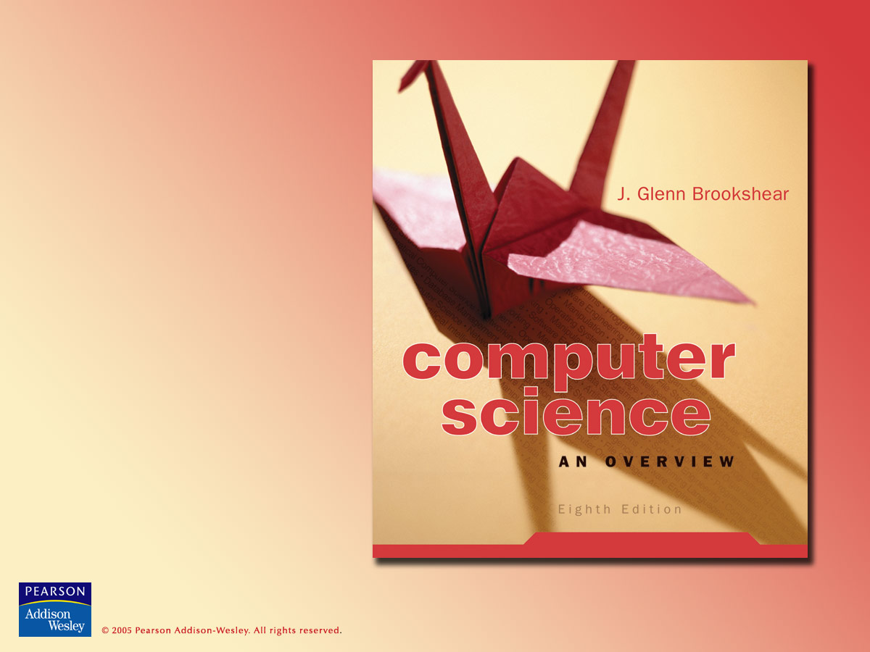
Chapter 11
Theory of Computation

Slide 2

Chapter 11: Theory of Computation
11.1 Functions and Their Computation
11.2 Turing Machines
11.3 Universal Programming Languages
11.4 A Noncomputable Function
11.5 Complexity of Problems
11.6 Public Key Cryptography

Slide 3
Functions
Function = the correspondence between a collection of possible input values and a collection of possible output values so that each possible input is assigned a single output
  Computing a function = determining the output value associated with a given set of input values
  Noncomputable function = a function that cannot be computed by any algorithm

Slide 4
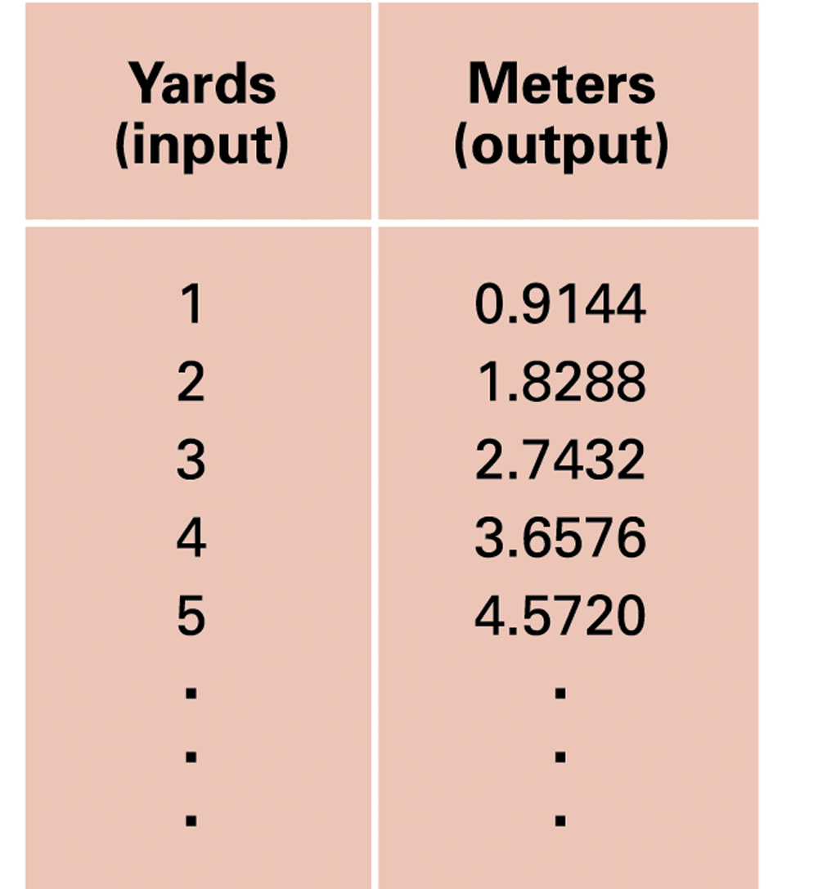
Figure 11.1 An attempt to display the function that converts measurements in yards into meters

Slide 5
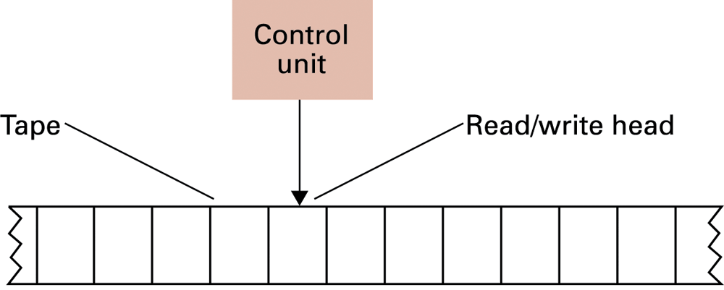
Figure 11.2 The components of a Turing machine

Slide 6
Turing machine operation
Inputs at each step
  State
  Value at current tape position
Actions at each step
  Write a value at current tape position
  Move read/write head
  Change state

Slide 7
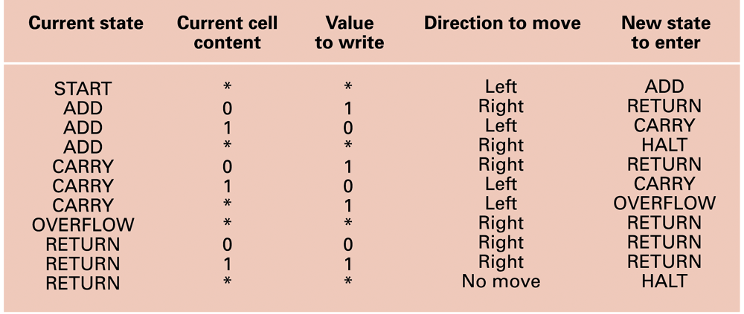
Figure 11.3 A Turing machine for incrementing a value

Slide 8
Universal programming language
Church-Turing thesis: A Turing machine can compute any computable function.
  Restatement: any computable function is Turing computable
  Not proven, but generally accepted
Universal programming language = a language that can express a program to compute any computable function
  Examples: “Bare Bones” and most popular programming languages

Slide 9
The Bare Bones language
Bare Bones is a simple, yet universal language.
Statements
  clear name;
  incr name;
  decr name;
  while name not 0 do; … end;

Slide 10
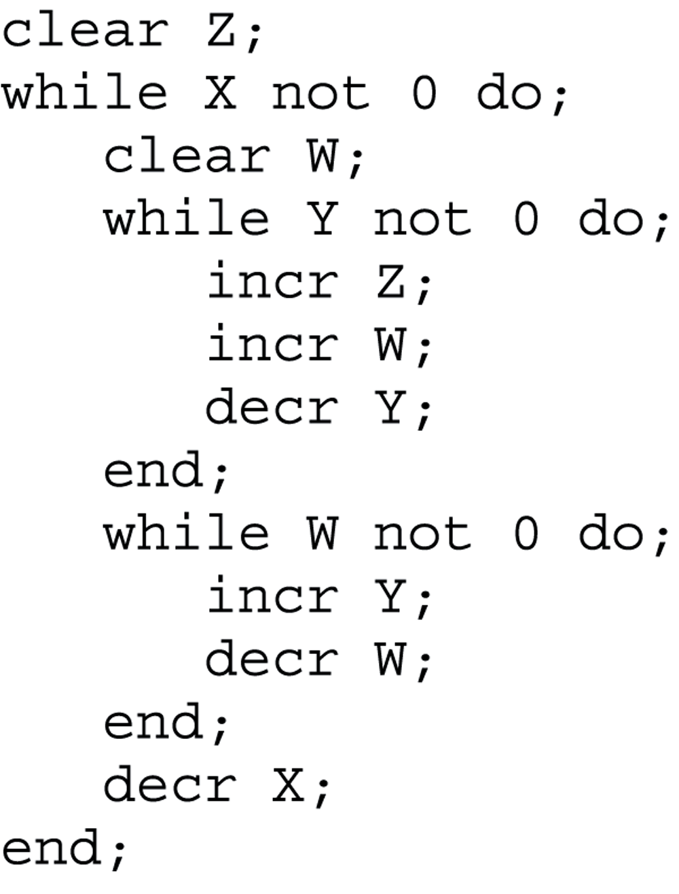
Figure 11.4 A Bare Bones program for computing X x Y

Slide 11
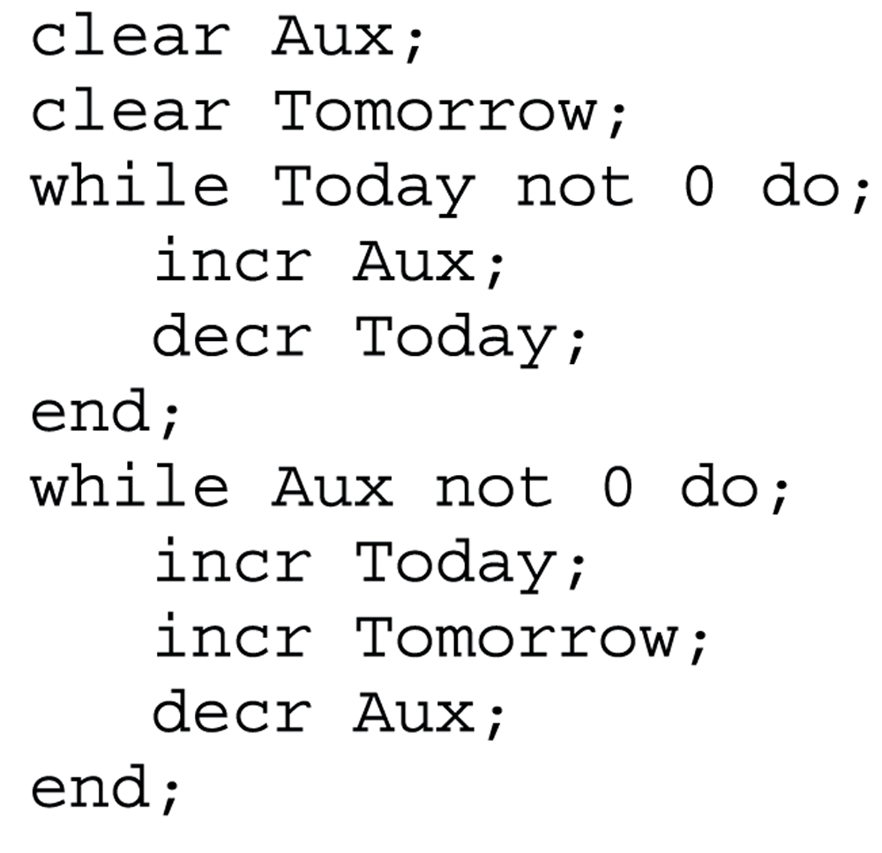
Figure 11.5 A Bare Bones implementation of the instruction “copy Today to Tomorrow”

Slide 12
The halting problem
Given the encoded version of any program, return 1 if the program will eventually halt, or 0 if the program will run forever.

Slide 13
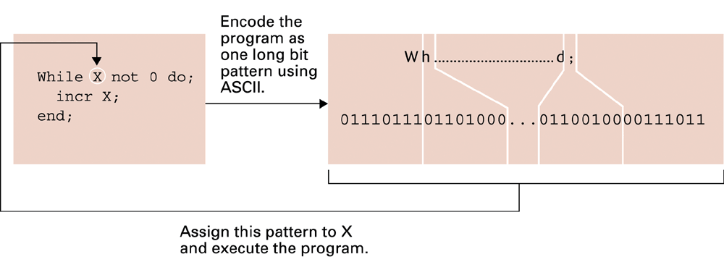
Figure 11.6 Testing a program for self-termination

Slide 14
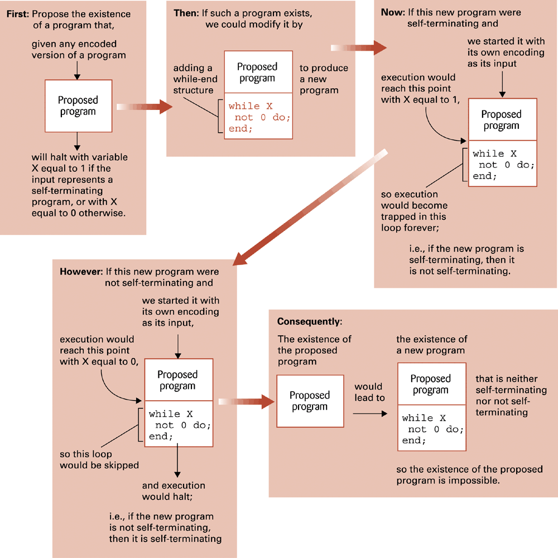
Figure 11.7 Proving the unsolvability of the halting program

Slide 15
Complexity of problems
Time complexity = number of instruction executions required
  Unless otherwise noted, “complexity” means “time complexity.”
A problem is in class O(f(n)) if it can be solved by an algorithm in Θ(f(n)).
A problem is in class Θ(f(n)) if the best algorithm to solve it is in class Θ(f(n)).

Slide 16
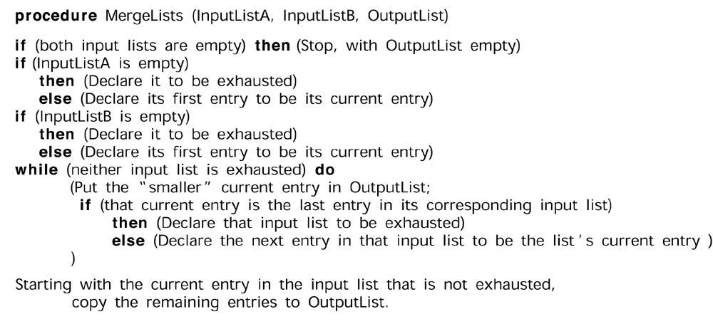
Figure 11.8 A procedure MergeLists for merging two lists

Slide 17
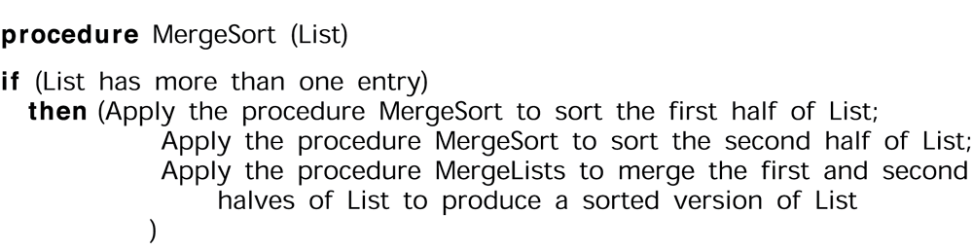
Figure 11.9 The merge sort algorithm implemented as a procedure MergeSort

Slide 18
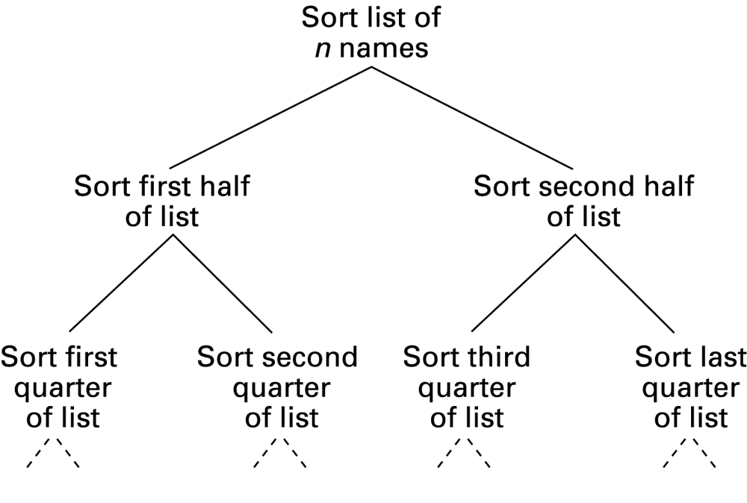
Figure 11.10 The hierarchy of problems generated by the merge sort algorithm

Slide 19
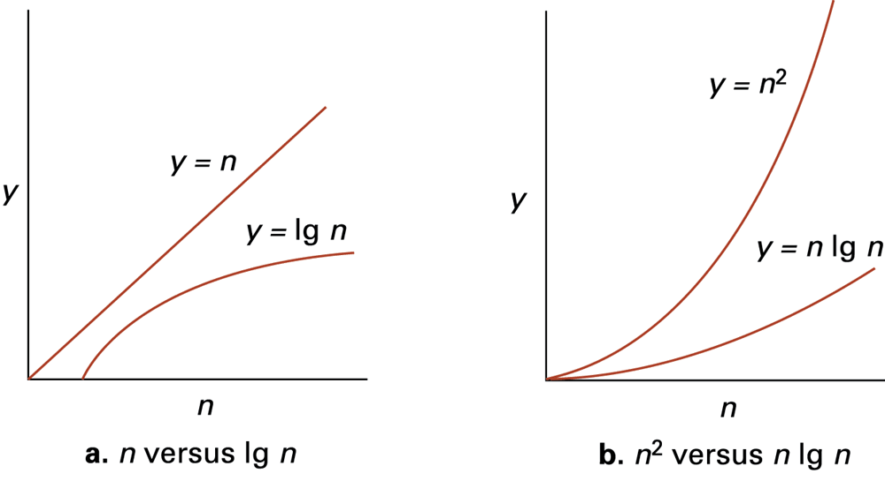
Figure 11.11 Graphs of the mathematical expression n, lg, n, n lg n, and n²

Slide 20
Class P
Class P = all problems in any class Θ(f(n)), where f(n) is a polynomial
Intractable = all problems too complex to be solved practically
  Most computer scientists consider all problems not in class P to be intractable.

Slide 21
Class NP
Class NP = all problems that can be solved by a nondeterministic algorithm in class P
  Nondeterministic algorithm = an “algorithm” whose steps may not be uniquely and completely determined by the process state
    May require “creativity”
Whether the class NP is bigger than class P is currently unknown.

Slide 22
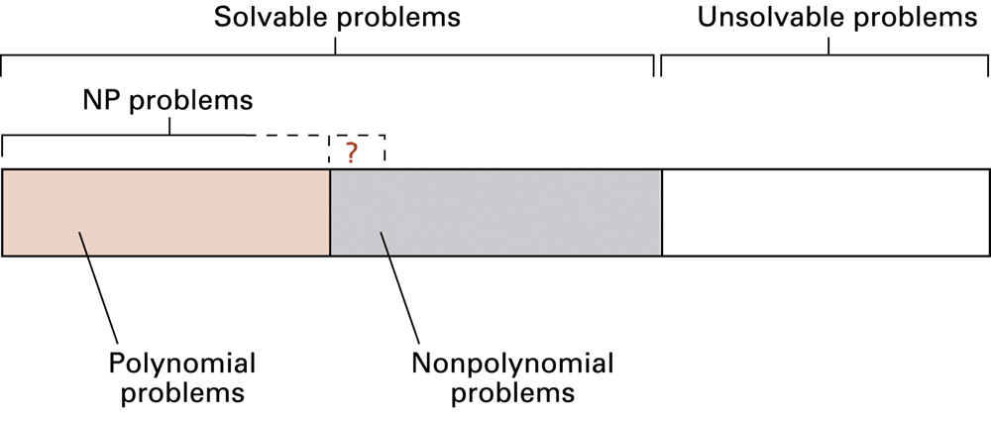
Figure 11.12 A graphic summation of the problem classification

Slide 23
Public key cryptography
Key = specially generated set of values used for encryption
  Public key: used to encrypt messages
  Private key: used to decrypt messages
RSA = a popular public key cryptographic algorithm
  Relies on the (presumed) intractability of the problem of factoring large numbers

Slide 24
Encrypting the message 10111
Encrypting keys: n = 91 and e = 5
10111_{two} = 23_{ten}
23e = 23⁵ = 6,436,343
6,436,343 ÷ 91 has a remainder of 4
4_{ten} = 100_{two}
Therefore, encrypted version of 10111 is 100.

Slide 25
Decrypting the message 100
Decrypting keys: d = 29, n = 91
100_{two} = 4_{ten}
4^{d} = 4²⁹ = 288,230,376,151,711,744
288,230,376,151,711,744 ÷ 91 has a remainder of 23
23_{ten} = 10111_{two}
Therefore, decrypted version of 100 is 10111.

Slide 26
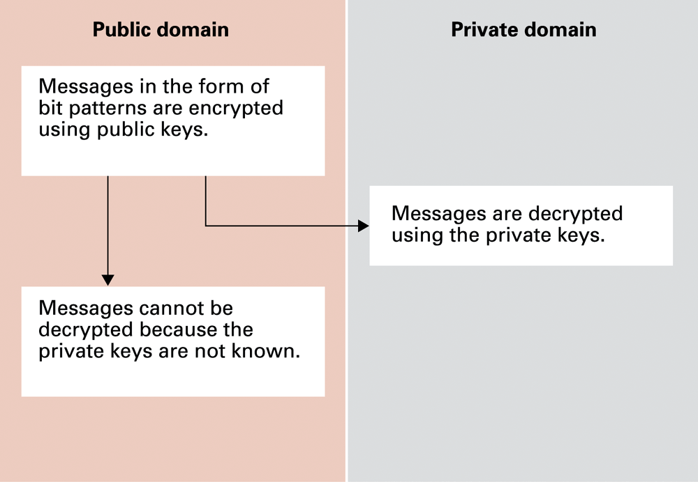
Figure 11.13 Public key cryptography

Slide 27
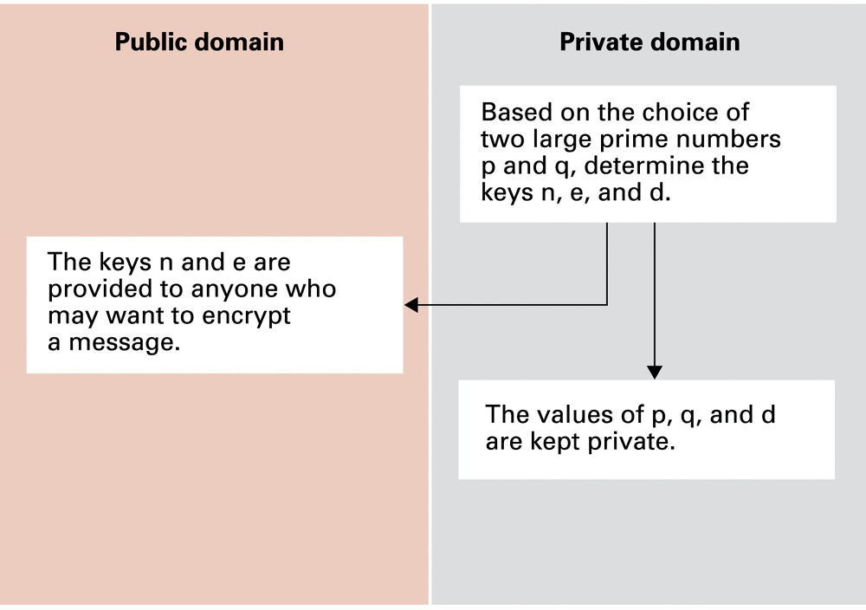
Figure 11.14 Establishing a RSA public key encryption system

